Slide 1


Typing and resistance genes
MODULE 3 · DAY 3
Who is causing infection, and what resistance do they carry?
Neonatal AMR genomic surveillance of K. pneumoniae and E. coli
KlebGen training · Africa CDC and ILRI
Module 3 · Typing and AMR genes | Day 3
Notes:
Day 3. Yesterday every isolate got one best assembly. Today we ask two questions of those assemblies. Morning, Module 3: what species and lineage is each isolate? Afternoon, the detection part of Module 4: which resistance and virulence genes does it carry? Tomorrow we compare these genotypes with the lab's antibiotic susceptibility results.

Slide 2

Day 3 at a glance
Session | Time | Topic | Module
1 | 09:00–10:30 | Species identification within the K. pneumoniae species complex | 3
2 | 11:00–12:30 | MLST, high-risk clones, global context in Pathogenwatch | 3
3 | 13:30–15:00 | AMR gene detection with AMRFinderPlus and Kleborate | 4
4 | 15:30–17:00 | Virulence loci and convergent strains | 4
You will produce
a one-page lineage summary, and a gene-by-isolate resistance table
Module 3 · Typing and AMR genes | Day 3
2
Notes:
Morning: Module 3, species and lineage. Afternoon: the detection half of Module 4, resistance and virulence genes. Everything today starts from the best assembly per isolate in $COURSE/best, made at the end of Day 2.

Slide 3
By the end of today you can
1
Confirm species within the K. pneumoniae species complex (KpSC), and explain why lab methods often miss K. quasipneumoniae and K. variicola.
2
Assign MLST sequence types (STs) and recognise high-risk clones.
3
Detect acquired resistance genes and chromosomal mutations, and tell intrinsic genes from acquired ones.
4
Read Kleborate's resistance and virulence scores, and spot convergent (resistant and hypervirulent) strains.
Today's input: the best assembly per isolate, in $COURSE/best/
Module 3 · Typing and AMR genes | Day 3
3
Notes:
Objectives 1 and 2 are Module 3 (this morning); 3 and 4 are the detection part of Module 4 (this afternoon).

Slide 4
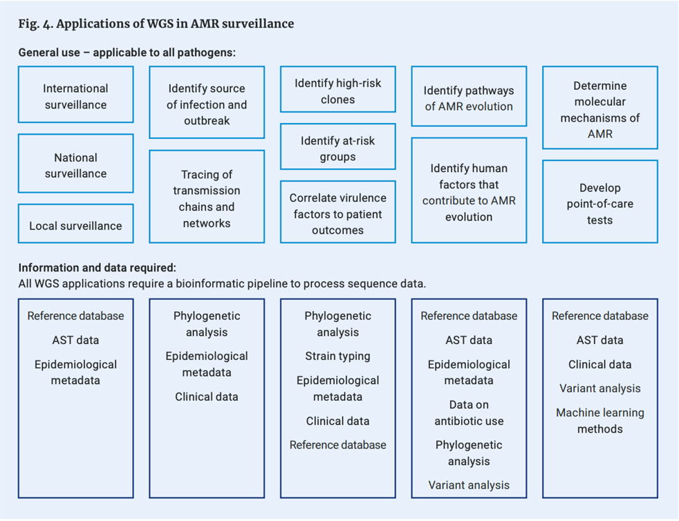
Applications of WGS in AMR surveillance
Every application needs a bioinformatic pipeline, and most need a reference database.
Today
Strain typing to identify high-risk clones, and reference databases to find the genes behind resistance.
Later in the course
AST data (Day 4), phylogenetics and transmission chains (Days 6–7).
World Health Organization. who.int/publications/i/item/9789240011007
Module 3 · Typing and AMR genes | Day 3
4
Notes:
This WHO figure lists what WGS is used for in AMR surveillance, from international to local surveillance, tracing transmission and identifying high-risk clones and resistance mechanisms, and the data each application needs. Today covers two of those inputs: strain typing and the reference databases of resistance genes.

Slide 5

Which species is it?
SESSION 1 · 09:00–10:30
The K. pneumoniae species complex, and genotyping with Kleborate
Module 3 · Typing and AMR genes | Day 3
5
Notes:
Session 1. Every isolate in this study arrived labelled K. pneumoniae. The genome lets us check that, and Kleborate does it in the same run as typing, resistance and virulence screening.

Slide 6
The K. pneumoniae species complex
Several closely related species that the lab usually reports as "K. pneumoniae"
Why it matters for surveillance
Species counts in reports are wrong if the complex is lumped together.
K. pneumoniae
K. quasipneumoniae (subsp. quasipneumoniae, similipneumoniae)
K. variicola (subsp. variicola, tropica)
K. quasivariicola, K. africana
Why it matters for resistance
The intrinsic beta-lactamase differs: SHV in K. pneumoniae, LEN in K. variicola.
MALDI-TOF and biochemical tests often cannot tell them apart. The genome can.
Exercise
All 29 training isolates were labelled K. pneumoniae. Which are not?
Module 3 · Typing and AMR genes | Day 3
6
Notes:
Answer to the exercise, from the study's published typing (metadata_compact.tsv, column published_species): 1013757 is K. variicola subsp. variicola (one of the three hybrid isolates); CAAYXM is K. variicola subsp. variicola; CAAQN6 is K. quasipneumoniae subsp. similipneumoniae. All three belong to the KpSC, which is why Kleborate types them too.

Slide 7
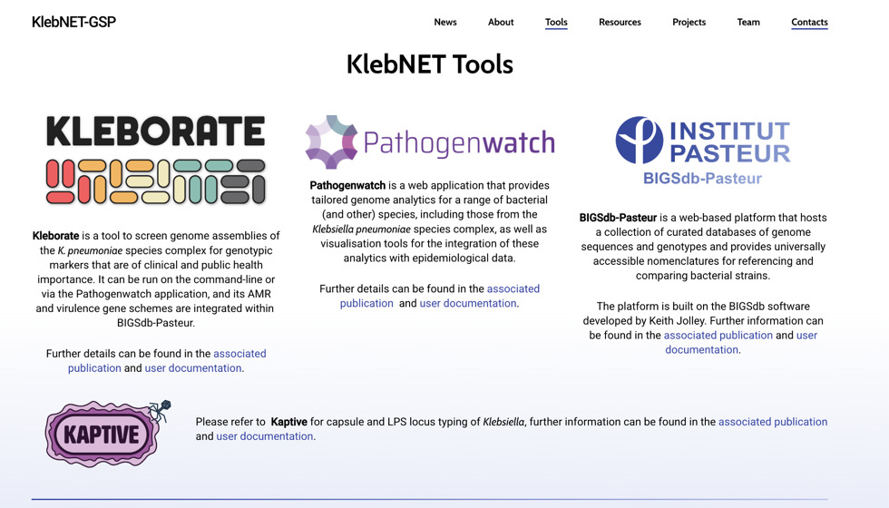
Pathogen-specific tools: KlebNET-GSP
Kleborate screens an assembly in one run for:
species
MLST sequence type
resistance genes and mutations
virulence loci
capsule (K) and O-antigen types (Kaptive)
Used to monitor which lineages cause disease, how they acquire resistance and virulence, and K and O antigen diversity for vaccines.
KlebNET-GSP: a harmonised platform for global genomic surveillance of K. pneumoniae
Module 3 · Typing and AMR genes | Day 3
7
Notes:
KlebNET-GSP brings together the tools built for Klebsiella genomic surveillance: Kleborate for genotyping on the command line, Pathogenwatch for web-based analysis and global context, BIGSdb-Pasteur for curated nomenclature, and Kaptive for capsule and O-antigen typing. Kleborate is what we run today, and its AMR and virulence schemes are also used in BIGSdb-Pasteur and Pathogenwatch. The three goals: monitor which lineages cause disease in different settings (hospital- or community-acquired), track how they acquire resistance and virulence, and assess K and O antigen diversity, which matters for vaccine design (Day 8).

Slide 8

Hands-on: Kleborate on all 29 isolates
use_tools typing
kleborate --version
mkdir -p $RESULTS/03_typing
kleborate -a $COURSE/best/*.fasta -o $RESULTS/03_typing/kleborate -p kpsc
# One wide table: pick prints only the columns that match a pattern
K=$RESULTS/03_typing/kleborate/klebsiella_pneumo_complex_output.txt
head -1 $K | tr '\t' '\n' | head -30 # list the column names
pick 'species$|__ST$' $K
Compare Kleborate's species call with the label each isolate arrived with. Which three are not K. pneumoniae?
Module 3 · Typing and AMR genes | Day 3
8
Notes:
-p kpsc runs the K. pneumoniae species complex preset. The output table is very wide, so use the pick function from the Day 1 setup. Answer: 1013757 and CAAYXM are K. variicola subsp. variicola; CAAQN6 is K. quasipneumoniae subsp. similipneumoniae.

Slide 9

Which lineage is it?
SESSION 2 · 11:00–12:30
MLST, higher-resolution typing, high-risk clones and global context
Module 3 · Typing and AMR genes | Day 3
9
Notes:
Session 2. Species is not enough for surveillance: within K. pneumoniae, a few lineages (high-risk clones) cause most of the resistant infections. Typing tells us which lineage each isolate belongs to.

Slide 10
Bacterial sequence typing
Typing gives each isolate geno- or phenotypic characters that reveal the sources and routes of spread of bacteria, and flag emerging pathogenic strains or clones within a species.
Molecular
Serological
Multi-locus sequence typing (MLST), and higher-resolution cgMLST, wgMLST and SNPs
Serogrouping and serotyping, now predicted from the genome: e.g. Kaptive for capsule (K) and O antigens
Module 3 · Typing and AMR genes | Day 3
10
Notes:
Typing answers "are these isolates the same strain?" at different resolutions. Serological typing used to need antisera; for Klebsiella, Kaptive now predicts capsule and O types from the genome, which we cover on Day 8. This session focuses on MLST, the standard nomenclature for lineages.

Slide 11
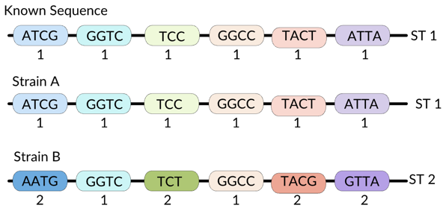
Multilocus sequence typing (MLST)
Internal fragments of (usually) seven housekeeping genes, about 450–500 bp each
Each distinct sequence of a gene is an allele number
Each unique combination of the seven alleles is a sequence type (ST)
Question
Kleborate reports ST14-1LV. What does the suffix mean?
Adapted from kiepczi.github.io/MLST_MicroSoc
Module 3 · Typing and AMR genes | Day 3
11
Notes:
MLST is unambiguous and portable: ST39 means the same thing in every lab, which is why it is the common language for lineages. Answer to the question: ST14-1LV means the allele profile matches ST14 at all but one of the seven genes, a single-locus variant. It is closely related to ST14 but not an exact match to a defined ST, perhaps because the allele is new or the gene sits at a contig break.

Slide 12
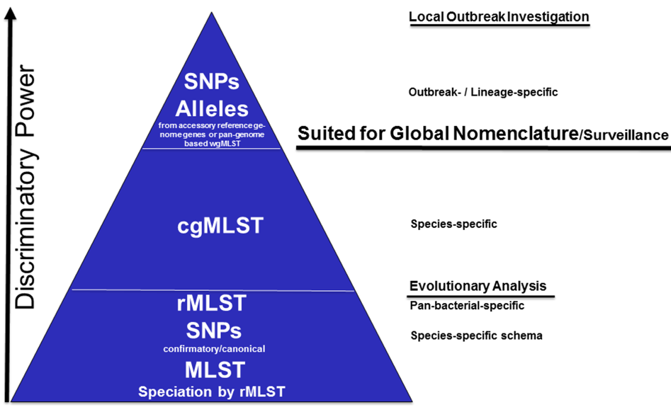
Beyond seven genes: cgMLST and wgMLST
cgMLST
Alleles of hundreds to thousands of core genes, e.g. 1,861 loci for S. aureus against 7 for MLST. The core genome shrinks as the sample set grows more diverse.
wgMLST
Core plus accessory loci: higher resolution for closely linked outbreak clusters.
Why it matters
Isolate-specific genotypes make it possible to detect transmission, e.g. prospective surveillance of multidrug-resistant bacteria in a hospital.
Module 3 · Typing and AMR genes | Day 3
12
Notes:
The pyramid ranks typing methods by discriminatory power. MLST and rMLST at the base are good for species and long-term evolution. cgMLST in the middle is suited to global nomenclature and surveillance: it is species-specific and its allele numbers are shareable. wgMLST alleles and SNPs at the top separate isolates within an outbreak. Key point for this course: two isolates of the same ST can differ by hundreds of SNPs and be years apart, so ST alone never proves transmission. That needs whole-genome resolution, which we do on Day 6.

Slide 13

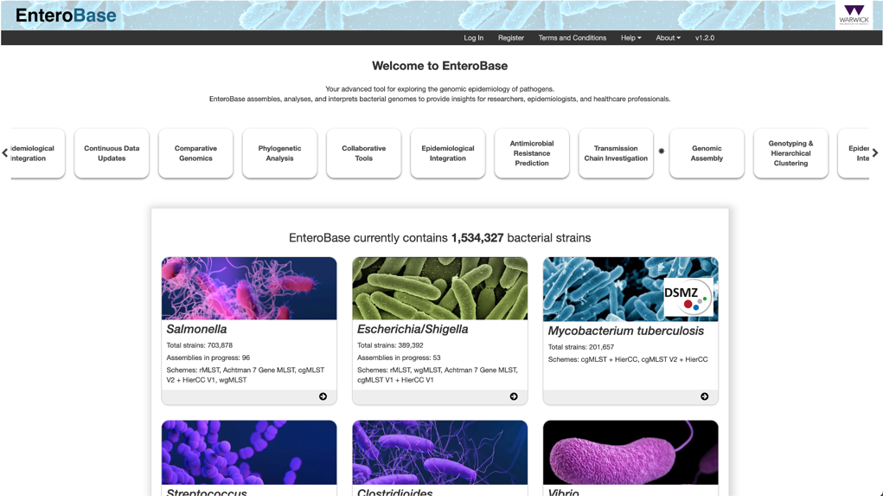
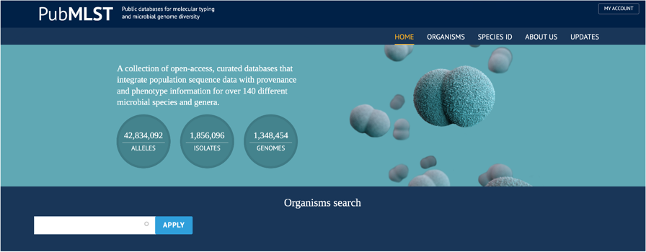
Typing databases
PubMLST
BIGSdb-Pasteur
EnteroBase
Open-access, curated databases for over 140 species and genera: population sequence data with provenance and phenotype. MLST, cgMLST and wgMLST schemes.
BIGSdb software stores and analyses isolate sequences, from a few loci to whole genomes, and groups loci into schemes. Hosts the Klebsiella nomenclature.
Assembles, analyses and interprets genomes of Salmonella, Escherichia/Shigella and others: MLST, cgMLST and hierarchical clustering.
Module 3 · Typing and AMR genes | Day 3
13
Notes:
Three databases you will meet. PubMLST (Oxford) hosts typing schemes for many species and does gene-by-gene analysis of deposited genomes. BIGSdb is the software behind PubMLST; the Institut Pasteur runs its own instance, BIGSdb-Pasteur, which hosts the Klebsiella MLST and cgMLST nomenclature that Kleborate uses. EnteroBase (Warwick) is the main resource for Salmonella and Escherichia/Shigella, including E. coli MLST and cgMLST with hierarchical clustering (HierCC). Since 2025, BIGSdb-Pasteur requires registration to access data curated after 1 January 2025.

Slide 14
Hands-on: lineages in the training set
# How many isolates per ST?
pick '__ST$' $K | tail -n +2 | cut -f2 | sort | uniq -c | sort -rn
# Compare with the published STs
cut -f1,7 $COURSE/training_data/metadata_compact.tsv
High-risk clones to recognise
Question
K. pneumoniae: ST307, ST147, ST15, ST17, ST39, ST14
E. coli: ST131, ST410, ST167, ST648
Which ST is most common? Is that a fair estimate of what causes neonatal infection in Blantyre?
Module 3 · Typing and AMR genes | Day 3
14
Notes:
Answer: ST39 (12 of 29), then ST35 (6). But this is not a fair estimate: the training set was chosen to contain two clusters, so those STs are over-represented on purpose. Prevalence must come from a representative sample (all isolates, or a random subset), never from a hand-picked one. This is the most common error in genomic surveillance reports. The one-page lineage summary you write today must say this.

Slide 15

Global context in Pathogenwatch
Go to pathogen.watch and create a free account.
Upload 5 assemblies from $COURSE/best/ (drag and drop the FASTA files).
Compare Pathogenwatch's species and ST with yours.
Open the LIN code and cgMLST results: which of your isolates fall closest to genomes from other countries?
Optional: E. coli typing
If your trainers have added E. coli genomes:
kleborate -a $COURSE/best/EC_*.fasta \
-o $RESULTS/03_typing/kleborate_ecoli \
-p escherichia
ectyper -i $COURSE/best/EC_01.fasta \
-o $RESULTS/03_typing/ectyper_EC_01
ezclermont $COURSE/best/EC_01.fasta
Upload only data you are allowed to share. The training data is public; your own surveillance data may not be.
MLST, O:H serotype and phylogroup
Module 3 · Typing and AMR genes | Day 3
15
Notes:
Pathogenwatch is part of the KlebNET-GSP toolkit: it runs Kleborate and cgMLST on uploaded genomes and places them among public genomes from around the world. LIN codes are a hierarchical cgMLST-based nomenclature for Klebsiella. Remind participants about data-sharing agreements before they upload anything of their own.

Slide 16

Which resistance genes?
SESSION 3 · 13:30–15:00 · MODULE 4
Finding AMR genes and mutations with AMRFinderPlus and Kleborate
Module 3 · Typing and AMR genes | Day 3
16
Notes:
Session 3 starts Module 4. We search each assembly against curated databases of resistance genes and mutations, compare two tools, and separate the genes every Klebsiella carries from the ones it acquired.

Slide 17
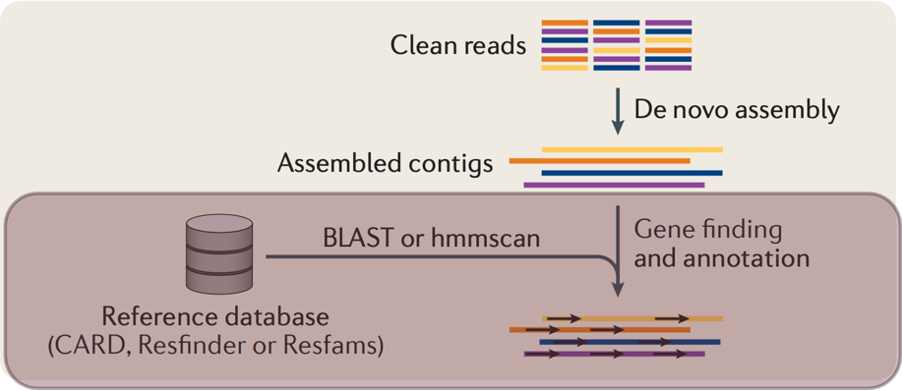
Contig-based AMR gene prediction
Curated databases link known genetic determinants of resistance to the antimicrobials they confer phenotypic resistance against.
They accumulate evidence from many studies that tested bacteria carrying specific resistance genes (AST).
Boolchandani M, et al. Nat Rev Genet 2019. doi:10.1038/s41576-019-0108-4
Module 3 · Typing and AMR genes | Day 3
17
Notes:
This is the assembly branch from yesterday's workflow figure, continued: the contigs are searched against a reference database of resistance genes. A tool is only as good as its database, and the database is only as good as the phenotypic evidence behind each entry. That is why tomorrow we compare the genes we find today with the lab's AST results.

Slide 18
Assembly-based versus read-based detection
Assembly-based
Read-based
Computationally expensive and slow, especially for large, complex communities
Finds known and novel genes with low similarity to the database, but needs high genome coverage
Captures genomic context: regulatory and mobile-element sequences
Fast and less demanding: suits very large data sets
Only as complete as the reference database for the organisms analysed
Loses nearby genes and genomic context; spurious mapping can give false positives
Source: Boolchandani M, et al. Nat Rev Genet 2019. This course uses the assembly-based approach on isolate genomes.
Module 3 · Typing and AMR genes | Day 3
18
Notes:
For isolates, assembly is cheap and gives genomic context, which we need for plasmid work on Days 4 and 5: is the gene on the chromosome or a plasmid, and what mobile elements surround it? Read-based approaches matter more for metagenomes, where assembly is hard.

Slide 19
Common AMR detection tools
 | ResFinder 4 (CGE) | RGI (CARD) | AMRFinderPlus (NCBI)
Database | Nucleotide | Protein | Protein
Input | Assemblies or reads | Nucleotide or protein sequence | Nucleotide and protein sequence
Method | Nucleotide BLAST; one identity and one length threshold | BLAST with manual cut-offs | BLAST and HMMs with manually curated cut-offs
Strengths | Fast | Can broaden the search to novel mechanisms, especially efflux pumps | Explicitly reports partial genes and internal stop codons
Web access | Online interface | Online interface and ontology (ARO) | No online interface (>800,000 isolates in MicroBIGG-E)
ResFinder can misassign alleles: the closest amino-acid hit is not always the closest nucleotide hit. Today we use AMRFinderPlus, and Kleborate's AMR screen for comparison.
Module 3 · Typing and AMR genes | Day 3
19
Notes:
Three widely used tools, each tied to its own curated database. ResFinder is quick and has a web interface, but its single nucleotide threshold can call the wrong allele. RGI uses CARD and its antibiotic resistance ontology. AMRFinderPlus, which we use, combines BLAST and hidden Markov models with curated cut-offs, reports partial and interrupted genes explicitly, and with --organism also checks species-specific point mutations. NCBI's MicroBIGG-E browser holds AMRFinderPlus results for public isolates.

Slide 20
Hands-on: AMRFinderPlus
use_tools amr
AMRDB=$SHARED/databases/amrfinderplus/latest
amrfinder -d $AMRDB --database_version
mkdir -p $RESULTS/04_amr/amrfinderplus
for f in $COURSE/best/*.fasta; do
s=$(basename $f .fasta)
amrfinder -n $f --organism Klebsiella_pneumoniae --plus --name $s \
-d $AMRDB --threads $THREADS -o $RESULTS/04_amr/amrfinderplus/${s}.tsv
done
# All results in one table (one header line)
awk 'FNR==1 && NR!=1 {next} {print}' $RESULTS/04_amr/amrfinderplus/*.tsv \
> $RESULTS/04_amr/amrfinderplus_all.tsv
--organism Klebsiella_pneumoniae
--plus
Also checks species-specific point mutations, e.g. in gyrA, parC, ompK35/36
Adds virulence, stress and metal-resistance genes
Module 3 · Typing and AMR genes | Day 3
20
Notes:
Always record the database version: results change as the database grows, and two runs are only comparable with the same version. The course uses one shared database for everyone. For E. coli isolates use --organism Escherichia instead.

Slide 21
Exercise: the key genes
Group | Examples | Isolates with ≥ 1
ESBL | blaCTX-M-15, SHV ESBL variants
Carbapenemase | blaNDM, OXA-48-like, KPC, VIM
Aminoglycoside-modifying enzymes | aac(3)-II, aac(6')-Ib, aph(3')-VI
16S rRNA methylases | armA, rmtB
Colistin | mcr, mgrB disruption
Fluoroquinolone | qnr, gyrA/parC mutations
For each group, count how many of the 29 isolates carry at least one.
Then compare with the published Kleborate results (in the notes).
A=$RESULTS/04_amr/amrfinderplus_all.tsv
pick 'Element symbol|^Class$|^Subclass$' $A | head # sample, gene and drug class
pick 'Element symbol|^Subclass$' $A | grep -i carbapenem | sort -u # carbapenemases
Module 3 · Typing and AMR genes | Day 3
21
Notes:
Answers from the published Kleborate results: CTX-M-15 in 21 of 29 isolates. NDM-1 in 2 isolates, BHB7VE (ST39) and CES1C7 (ST45). Acquired aminoglycoside resistance genes in 27 of 29; 23 carry an aac(3) gene, which typically confers gentamicin resistance. Counts from AMRFinderPlus may differ slightly: the two tools use different databases and versions.

Slide 22
Exercise: AMRFinderPlus versus Kleborate
pick 'Bla_ESBL_acquired$|Bla_Carb_acquired$|AGly_acquired$|resistance_score$' $K
Choose 5 isolates and compare the two tools gene by gene. Write down every difference and a likely reason:
Database
Gene name
Truncated gene
Contig break
Different sources and versions
The same gene under another name
Partial or interrupted: called by one tool only
The gene is split across two contigs
Module 3 · Typing and AMR genes | Day 3
22
Notes:
K is the Kleborate output table from this morning. The four reasons cover most disagreements. Contig breaks are common in short-read assemblies because resistance genes often sit next to IS elements (Day 2). Hybrid isolates should show fewer differences.

Slide 23
Intrinsic versus acquired
K. pneumoniae always carries a chromosomal blaSHV (usually SHV-1 or SHV-11); K. variicola carries blaLEN.
WHY IT MATTERS FOR NEONATES
The WHO first-line empiric regimen for neonatal sepsis is ampicillin plus gentamicin. Against K. pneumoniae, ampicillin adds nothing: the regimen relies on gentamicin alone.
Both make the species naturally resistant to ampicillin. Kleborate lists them in their own column (Bla_chr), so they are not mistaken for acquired resistance.
So gentamicin resistance genes, such as aac(3)-II, decide whether first-line treatment can work.
Module 3 · Typing and AMR genes | Day 3
23
Notes:
This is the link between today's gene lists and patient care. Because ampicillin resistance is intrinsic, a K. pneumoniae isolate with an acquired aac(3) gene is effectively untreatable with the first-line regimen. In this training set 23 of 29 isolates carry an aac(3) gene (published Kleborate results). We return to this on Day 4 with the AST data.

Slide 24
Virulence and convergence
SESSION 4 · 15:30–17:00 · MODULE 4
Virulence loci, Kleborate scores, and strains that are both resistant and hypervirulent
Module 3 · Typing and AMR genes | Day 3
24
Notes:
Session 4. Resistance limits treatment; virulence makes infections more severe. Kleborate scores both, and the combination, a convergent strain, is what surveillance must flag immediately.

Slide 25
Virulence loci in Kleborate
Locus | What it does
Yersiniabactin (ybt) | Siderophore; common in hospital lineages
Aerobactin (iuc) | Siderophore strongly linked to hypervirulence
Salmochelin (iro) | Siderophore, often with iuc on the virulence plasmid
Colibactin (clb) | Genotoxin
rmpADC / rmpA2 | Hypermucoidy
pick 'virulence_score$|Yersiniabactin$|Aerobactin$|Salmochelin$|Colibactin$|RmpADC$|rmpA2$' $K
Module 3 · Typing and AMR genes | Day 3
25
Notes:
Kleborate's virulence score summarises these loci: siderophores help the bacteria take iron from the host, and rmp genes make the capsule hypermucoid. Aerobactin and rmp are the markers of hypervirulent K. pneumoniae.

Slide 26

Convergent strains
A convergent strain carries a carbapenemase and aerobactin or rmp. Report it immediately: very limited treatment options combined with high virulence.
Highest virulence scores in the training set (published Kleborate v2 results)
Isolate | Score | Loci
CAAUM3 (ST1049, KL5) | 4 | yersiniabactin (ybt 2, ICEKp1); aerobactin iuc 3 truncated; salmochelin iro 3 truncated; rmp 3 (ICEKp1)
1013757 (K. variicola) | 3 | aerobactin iuc 5; salmochelin iro 5
Is either convergent? Does a truncated aerobactin locus still count towards hypervirulence?
Module 3 · Typing and AMR genes | Day 3
26
Notes:
Neither isolate carries a carbapenemase, so neither is convergent. Two points to discuss: in CAAUM3 the aerobactin genes are truncated, so does a broken locus still count towards hypervirulence? And 1013757 is a hybrid isolate with closed plasmids: on Day 4 you can find which plasmid carries iuc 5.

Slide 27
Check your understanding
1
Kleborate reports ST14-1LV. What does the suffix mean?
2
Why might two isolates with the same ST still be unrelated in a hospital outbreak?
3
ST39 is 12 of our 29 isolates. Why is that not its prevalence in Blantyre?
4
Why does gentamicin resistance decide whether first-line treatment of K. pneumoniae sepsis can work?
Module 3 · Typing and AMR genes | Day 3
27
Notes:
Answers. 1: a single-locus variant: the profile matches ST14 at six of the seven genes. 2: MLST looks at seven genes; isolates of one ST can differ by hundreds of SNPs across the genome and be years apart, so transmission needs whole-genome resolution (Day 6). 3: the training set was chosen to contain two clusters, so ST39 and ST35 are over-represented on purpose; prevalence needs a representative sample. 4: ampicillin resistance is intrinsic (chromosomal SHV or LEN), so ampicillin plus gentamicin relies on gentamicin alone; an acquired aac(3) gene removes it.

Slide 28


End-of-day checklist
Kleborate results for all 29 isolates in $RESULTS/03_typing/kleborate/
You found the three non-K. pneumoniae isolates
One-page lineage summary: an ST count table or bar chart, and three sentences of interpretation, including why these counts are not prevalence
AMRFinderPlus results combined in $RESULTS/04_amr/amrfinderplus_all.tsv
The key-genes table is filled in
Module 3 · Typing and AMR genes | Day 3
28
Notes:
Tomorrow, Day 4, compares these genotypes with the lab's antibiotic susceptibility results and then starts plasmid reconstruction.

Slide 29
Further reading
Papers and reports
Tools and databases
Lam MMC, et al. A genomic surveillance framework and genotyping tool for Klebsiella pneumoniae and its related species complex. Nat Commun 2021.
Boolchandani M, et al. Nat Rev Genet 2019. doi:10.1038/s41576-019-0108-4
World Health Organization: WGS for AMR surveillance
MLST explained (kiepczi.github.io)
Kleborate and AMRFinderPlus
Pathogenwatch
PubMLST
BIGSdb-Pasteur
EnteroBase
Module 3 · Typing and AMR genes | Day 3
29

Slide 30
Questions?
Next: Day 4 · Genotype versus phenotype, empiric therapy, and plasmid reconstruction
Module 3 · Typing and AMR genes | Day 3
30
Notes:
Wrap up: every isolate now has a species, a lineage, and a list of resistance and virulence genes. Tomorrow we test whether those genes explain the lab's susceptibility results.

